Slide 1
Agenda
1.
Architecture Overview
High-level pipeline from CloudWatch to QuickSight
2.
Four Data Tables
What we collect: chat, conversations, feedback, agent hours
3.
PII Separation & Data Protection
How sensitive data is isolated and redacted
4.
Key Infrastructure Features
Parquet, partitioning, encryption, lifecycle
5.
Querying & Visualization
Athena SQL examples and QuickSight dashboards
6.
Access Control Model
Proposed QuickSight, Glue, and Athena permissions
Notes:
SPEAKER NOTES (30 sec)
Here's the agenda. We'll start with the big picture — how logs flow from applications to dashboards. Then the four tables we maintain, how PII is handled, the infrastructure features that make this production-grade, how to query the data, and finally the proposed access control model which is open for your feedback.

Slide 2
Architecture Overview
CloudWatch Log Groups
Subscription Filters
Kinesis Firehose + Lambda
Glue Schema + Parquet
S3 Partitioned
Athena Queries
QuickSight Dashboards
→
→
→
→
→
→
3 Log Groups
PII Redaction at Source
chat_logs, feedback_logs, agent_hours
CloudWatch Data Protection redacts SSN, emails, DOB before delivery
4 Firehose Streams
Hive-Style Partitioning
JSON extraction, timestamp enrichment, Parquet conversion via Glue schemas
year=/month=/day=/hour= for fast, cost-effective Athena queries
chat_logs has two subscription filters: one for the main table (PII stripped) and one for chat_conversations (PII redacted, with join keys)
Notes:
SPEAKER NOTES (2 min)
Let me walk through the pipeline. Applications write logs into three CloudWatch Log Groups — chat_logs, feedback_logs, and agent_hours.
Before anything leaves CloudWatch, a Data Protection Policy scans chat_logs and redacts PII like SSNs, credit cards, emails, and dates of birth.
Subscription filters forward logs to dedicated Kinesis Firehose streams. Each Firehose has a Lambda processor that extracts individual events from the CloudWatch subscription format and enriches them with UTC timestamps and array count columns.
Firehose converts JSON to Parquet using Glue table schemas and writes to S3 with Hive-style partitioning — year, month, day, hour.
S3 events trigger a partition registration Lambda, and then Athena can query via the Glue catalog. QuickSight visualizes through four datasets.
For chat_logs specifically, there are two filters — one strips PII fields for the main analytics table, another preserves the redacted versions in chat_conversations.

Slide 3
Architecture Reference
Pipeline flow for documentation and reference
CloudWatch Logs → Subscription Filter → Kinesis Firehose (Lambda processor: JSON extraction + enrichment) → Glue Schema Validation → Parquet Conversion → S3 (Hive partitioned: year=/month=/day=/hour=) → Glue Partition Lambda (auto-registers partitions) → Athena (SQL queries via Glue catalog) → QuickSight (dashboards, 4 datasets)
Log Groups and Table Mapping
chat_logs → chat-logs-firehose → S3: chat_logs/ → Glue: chat_logs (PII fields stripped)
chat_logs → chat-conversations-firehose → S3: chat_conversations/ → Glue: chat_conversations (PII redacted, join keys)
feedback_logs → feedback-logs-firehose → S3: feedback_logs/ → Glue: feedback_logs
agent_hours → agent-hours-firehose → S3: agent_hours/ → Glue: agent_hours
Notes:
SPEAKER NOTES (30 sec)
This slide is here as a reference — feel free to copy the architecture flow text for your own documentation or design docs. It shows the full pipeline path and the mapping from each log group through its Firehose stream to the final Glue table.
Notice chat_logs feeds two separate paths — one for the main analytics table and one for the PII-isolated chat_conversations table.

Slide 4
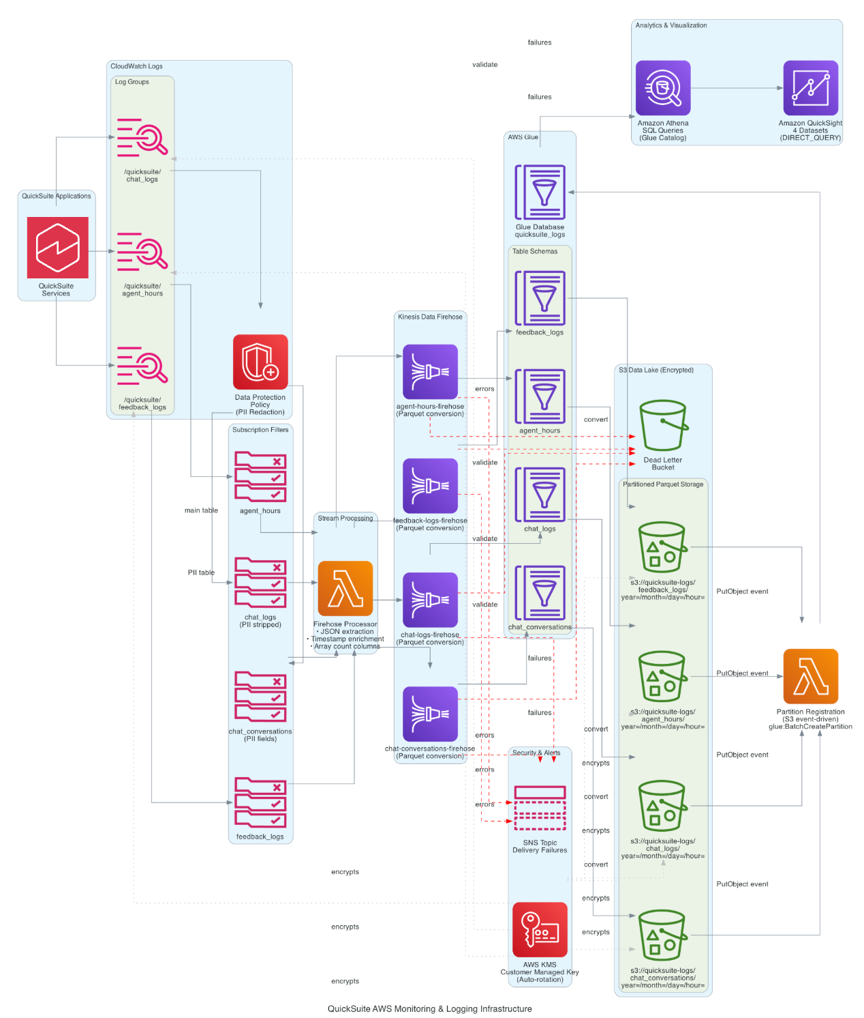
Architecture Overview
Notes:
SPEAKER NOTES (2 min)
Let me walk through the pipeline. Applications write logs into three CloudWatch Log Groups — chat_logs, feedback_logs, and agent_hours.
Before anything leaves CloudWatch, a Data Protection Policy scans chat_logs and redacts PII like SSNs, credit cards, emails, and dates of birth.
Subscription filters forward logs to dedicated Kinesis Firehose streams. Each Firehose has a Lambda processor that extracts individual events from the CloudWatch subscription format and enriches them with UTC timestamps and array count columns.
Firehose converts JSON to Parquet using Glue table schemas and writes to S3 with Hive-style partitioning — year, month, day, hour.
S3 events trigger a partition registration Lambda, and then Athena can query via the Glue catalog. QuickSight visualizes through four datasets.
For chat_logs specifically, there are two filters — one strips PII fields for the main analytics table, another preserves the redacted versions in chat_conversations.

Slide 5
Four Glue Tables
chat_logs
chat_conversations
feedback_logs
agent_hours
Main chat analytics
PII-isolated content
User feedback
Metered usage
PII fields stripped Latency, TTFT, resources, connectors, file attachments
user_message + system_text_message (redacted by CloudWatch) Join keys for reconstruction
Thumbs up/down, reasons, feedback details, linked to conversations
Subscription type, usage hours, service resource ARN, usage group tracking
All tables share Hive-style partitioning (year=/month=/day=/hour=) and are queryable via Athena through the Glue catalog
Notes:
SPEAKER NOTES (2 min)
We maintain four Glue tables, each served by its own Firehose stream.
chat_logs is the main analytics table — latency, time to first token, resources cited, connectors, file attachments — but PII fields are completely stripped. This is what most analysts use day to day.
chat_conversations is the PII-isolated table. It has user_message and system_text_message, but these are redacted by CloudWatch Data Protection before reaching the pipeline. Shares join keys with chat_logs for reconstruction via JOIN.
feedback_logs captures thumbs up/down, reasons, and free-text details.
agent_hours tracks metered usage — subscription types, hours consumed, service resource ARNs.

Slide 6
PII Separation Architecture
Path 1: Main Analytics
Path 2: PII-Isolated Content
CloudWatch chat_logs log group
CloudWatch chat_logs log group
→ Subscription filter strips PII fields
→ Data Protection redacts PII in-place
→ Firehose: chat-logs-firehose
→ Firehose: chat-conversations-firehose
→ S3: chat_logs/ prefix
→ S3: chat_conversations/ prefix
→ Glue table: chat_logs
→ Glue table: chat_conversations
Shared Join Keys
system_message_id / conversation_id / user_message_id / accountid / user_arn / partition columns
Analysts query chat_logs for day-to-day metrics. JOIN to chat_conversations when conversation content is needed.
Notes:
SPEAKER NOTES (2 min)
This is the key security design. The chat_logs CloudWatch log group feeds two separate subscription filters.
Path 1 strips PII fields entirely — user_message and system_text_message never make it into chat_logs. This is the table most people use for latency, TTFT, and usage analytics.
Path 2 preserves those fields but they've been redacted by CloudWatch Data Protection first. Names become asterisks, emails get masked, SSNs replaced. These go into chat_conversations.
Both tables share join keys — system_message_id, conversation_id, etc. — so you can reconstruct the full record with an Athena JOIN when needed.
This means broad access to chat_logs for dashboards, restricted access to chat_conversations for those who need conversation content.

Slide 7
CloudWatch Data Protection
What Gets Redacted
How It Works
Social Security Numbers
123-45-6789 → ***-**-****
—
Applied at CloudWatch log group level
—
Redaction happens before delivery to any subscriber
Credit Card Numbers
4111-1111-... → ****-****-...
—
Uses AWS managed data identifiers
Email Addresses
user@co.com → ****@****.***
—
Zero application code changes required
Dates of Birth
Identified and masked
—
Configured via Terraform data protection policy
Names (detected)
Pattern-matched and redacted
—
Covers chat_logs only (feedback and agent hours have no PII fields)
Notes:
SPEAKER NOTES (1.5 min)
CloudWatch Data Protection is the first line of defense. Applied at the log group level on chat_logs — the only group with user-generated content.
Redaction happens at the CloudWatch level before data reaches any subscriber. By the time Firehose sees data, PII is already masked.
It uses AWS managed data identifiers — SSNs, credit cards, emails, DOB, names. Detected values get replaced with asterisks.
Key benefit: zero code changes. The policy is configured entirely in Terraform.
Feedback and agent hours don't need this — no user-generated free-text content in those log groups.

Slide 8
Key Infrastructure Features
Parquet Format
Hive Partitioning
AWS KMS Encryption
Columnar storage via Firehose format conversion using Glue schemas. 70-90% smaller than JSON.
year=/month=/day=/hour= structure. Athena scans only relevant partitions. Significant cost and speed improvement.
Managed encryption service for cryptographic key management. Covers S3, CloudWatch, Firehose, and Athena query results.
Auto Partition Registration
Lifecycle Management
Timestamp Enrichment
S3 PutObject events trigger Lambda. Calls glue:BatchCreatePartition for all 4 tables automatically.
Glacier transition after 90 days. Deletion after 7 years. Dead-letter bucket for failed records.
Lambda adds timestamp_utc and event_timestamp_utc. Plus array count columns for QuickSight.
Notes:
SPEAKER NOTES (2 min)
Six features that make this production-grade.
Parquet format — Firehose converts JSON to Parquet via Glue schemas. Columnar storage, 70-90% smaller than raw JSON, and Athena reads only needed columns.
Hive partitioning — data organized by year, month, day, hour. Partition filters mean Athena scans only relevant directories. Faster queries, lower cost.
AWS KMS encryption — we use AWS Key Management Service for cryptographic key management across the pipeline. Covers S3, CloudWatch, Firehose, and Athena results.
Automatic partition registration — S3 PutObject events trigger a Lambda that calls BatchCreatePartition for all four tables. No manual MSCK REPAIR TABLE.
Lifecycle management — Glacier after 90 days, deletion after 7 years. Failed records go to a dead-letter bucket.
Timestamp enrichment — the Lambda processor adds UTC timestamps and array count columns like cited_resource_count and file_attachment_count for QuickSight aggregation.

Slide 9
Querying with Athena
Always include partition filters (year, month, day) for fast, cost-effective queries
Latency by User Type
Feedback Summary
Join for Full Record
SELECT user_type, AVG(latency) AS avg_latency_ms, COUNT(*) AS count FROM quicksuite_logs.chat_logs WHERE year=2026 AND month=3 GROUP BY user_type;
SELECT feedback_type, COUNT(*) AS count FROM quicksuite_logs.feedback_logs WHERE year=2026 AND month=3 GROUP BY feedback_type;
SELECT cl.*, cc.user_message FROM quicksuite_logs.chat_logs cl JOIN quicksuite_logs .chat_conversations cc ON cl.system_message_id = cc.system_message_id WHERE cl.year=2026 AND cl.month=3;
4 QuickSight datasets (one per table) visualize data via Athena DIRECT_QUERY mode — always up to date, no SPICE refresh needed
Notes:
SPEAKER NOTES (2 min)
Some example Athena queries. Golden rule: always include partition filters in your WHERE clause.
First — average latency by user type from chat_logs. Simple aggregation filtered to a specific month.
Second — feedback summary. Counts by feedback type.
Third and most interesting — reconstructing the full record by JOINing chat_logs with chat_conversations on system_message_id. Use this when you need conversation content alongside metrics.
Four QuickSight datasets — one per Glue table — all in DIRECT_QUERY mode against Athena. Dashboards always show current data without SPICE refresh schedules.

Slide 10
Proposed Access Control Model
PROPOSED — OPEN FOR FEEDBACK
QuickSight Dataset, Glue Table, and Athena query access by role and environment
Role / Environment
Glue Table Access
Athena Query Access
QuickSight Dataset Access
Admin PRO Non-Prod + Prod
Full read access to all 4 tables
Full query execution permissions
All 4 datasets: chat_logs, chat_conversations, feedback_logs, agent_hours
Author PRO Non-Prod
Full read access to all 4 tables
Full query execution permissions
All 4 datasets: chat_logs, chat_conversations, feedback_logs, agent_hours
Author PRO Prod
Limited read access 3 of 4 tables (chat_conversations excluded)
Full query execution permissions
3 datasets: chat_logs, feedback_logs, agent_hours
Key distinction: Author PRO in Prod cannot access chat_conversations (contains redacted but sensitive conversation content)
Notes:
SPEAKER NOTES (2 min)
This is the proposed access control model — currently under customer review and open for feedback.
There are three role-environment combinations.
Admin PRO gets the same access in both non-prod and prod: full read access to all four Glue tables, full Athena query execution, and all four QuickSight datasets. They can query chat_logs, chat_conversations, feedback_logs, and agent_hours.
Author PRO in non-prod also gets full access across all four tables, all Athena permissions, and all four QuickSight datasets.
The key distinction is Author PRO in prod. They get limited access — only three of the four tables. chat_conversations is explicitly excluded. Even though the content is redacted by CloudWatch Data Protection, it still contains conversation text that we want to restrict in production. So Author PRO in prod can query chat_logs, feedback_logs, and agent_hours, and see those three QuickSight datasets.
The same permission boundaries apply consistently across Glue table access, Athena query permissions, and QuickSight dataset visibility.
This is a proposed model — we'd welcome any feedback on the role definitions or the access boundaries.

